Slide 1


Credit Risk Scoring: A Stacking Generalization Approach
Bernardo Dias Raimundo
Prof. Dr. Jorge Miguel Ventura Bravo
Nova Information Management School
World Cist 2023

Slide 2
1
Introduction
A momentary overview
01
02
03
04
Credit Risk A significant concern for financial institutions
Banking Regulations The revised Basel accords and it’s contributions
Credit Scoring Methods Regression models and machine learning applications
Ensemble Learning Homogeneous and heterogenous ensembles
Page 2

Slide 3
1
Introduction
Research questions
01
How does an ensemble-based approach compare to single based classifiers when predicting the probability of default?
02
Given the ensemble-based approach, how sensitive is the outcome of the ensemble to different model combinations?
Credit Risk Scoring: A Stacking Generalization Approach
Page 3

Slide 4


2
Literature Review
How is the current research in credit risk modeling?
01
Altman, E. (1968). Financial Ratios, Discriminant Analysis, and the Prediction of Corporate Bankruptcy. The Journal of Finance, 23(4): 589–609.
02
Wolpert, D. (1992). Stacked Generalization. Neural Networks. 5. 241-259.
03
Dietterich, T.G. (2000). Ensemble methods in machine learning. Multiple Classifier Systems: First International Workshop, MCS 2000, Lecture Notes in Computer Science. 1-15.
04
Steel, M. F. J. (2020). Model Averaging and Its Use in Economics. Journal of Economic Literature, 58, 644–719.
05
Ashofteh, A., & Bravo, J. M. (2021). A conservative approach for online credit scoring. Expert Systems with Applications, 176, 1-16.
Credit Risk Scoring: A Stacking Generalization Approach
Page 4

Slide 5
3
Methodology
Exploratory Data Analysis:
Deep dive to understand the data, uncover interesting and hidden patterns and data visualization.
Data Preprocessing:
Machine learning pipelines will be used to split the process into a multistep workflow. This includes imputation, categorical encoding, scaling and principal component analysis.
Single Based Classifiers
Stacking Approach
Modeling:
Four different algorithms will be considered: K nearest neighbors, decision tree, support vector machine as level 0 models and the logistic regression as the meta model. In addition to this, a sampling technique was applied to deal with class imbalance.
– forward.
Performance Metrics:
Performance metrics such as accuracy, precision, recall and f1 score will be used to compare the performance of both approaches.
Page 5

Slide 6

4
Machine Learning application to online credit scoring
Exploratory data analysis
Summarized details of the dataset
Population
amount
Features
description
Population
amount
The dataset was provided by Lending Club. Initially it contained 2.26 million rows and 151 different features.
Personal details (e.g., address, employment status, home ownership)
Credit history (e.g., the balance of accounts and revolving and current past due accounts)
Loan characteristics (e.g., purpose, grade, term)
Removing features that contained more than 25% of missing data
Only loans with a final “status” and features available at the time of application were considered
The final dataset contains 1,345 rows and 33 features
Dataset transformation
Page 6

Slide 7
4
Machine Learning application to online credit scoring
Exploratory data analysis
Loan status distribution
Grades
Home Ownership
Fully Paid
1.076.751
Charged off
268.559
Purpose Occurance
Loan term
Debt Consolidation
780.231
Credit Card
292.272
Home Improvement
87.504
Other
77.875
1.020.743
36 months loans
324.567
60 months loans
Major Purchase
29.425
Medical
15.554
Business
15.416
Car
14.585
Moving
9.480
Loans issued by year
Vacation
9.065
House
7.253
Wedding
2.294
Energy
933
Education
326
Page 7

Slide 8
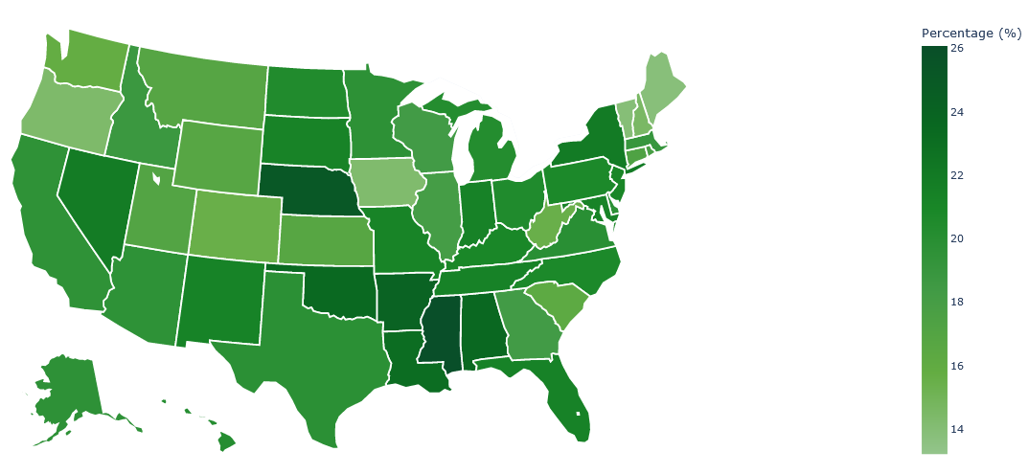
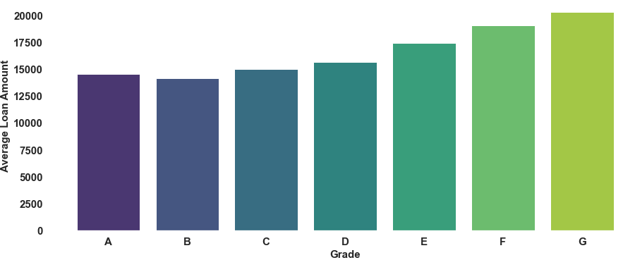
4
Machine Learning application to online credit scoring
Exploratory data analysis
Percentage of charged off loans
Employment title (Top 10 records)
Relationship between grade and loan amount
Type of application
1.399.510
Individual applications
25.800
Joint
applications
Page 8

Slide 9
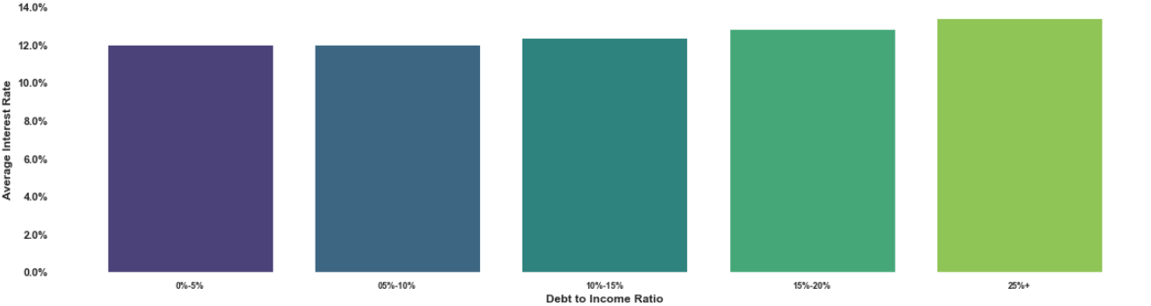
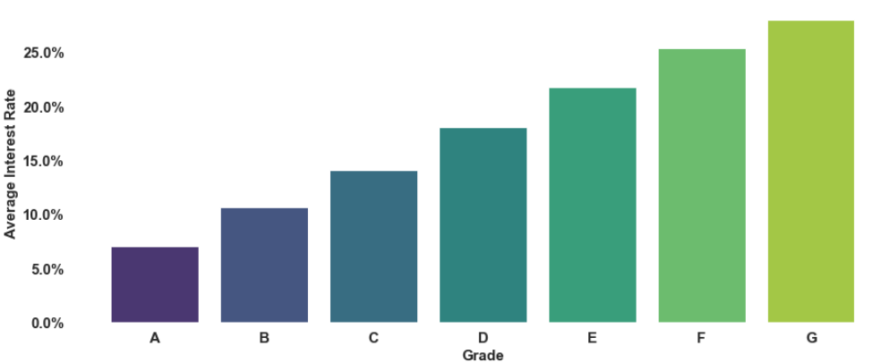
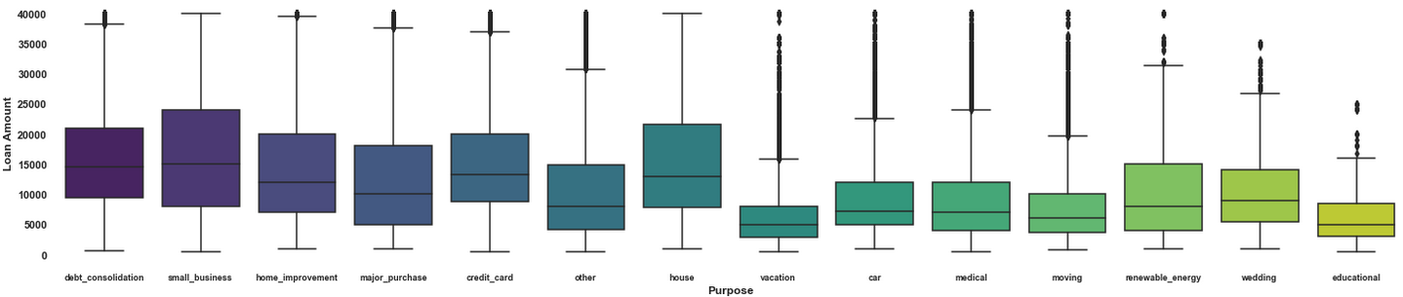
4
Machine Learning application to online credit scoring
Exploratory data analysis
Relationship between interest rate and debt to income ratio
Relationship between interest rate and grade
Relationship between purpose and loan amount
Page 9

Slide 10
4
Machine Learning application to online credit scoring
Exploratory data analysis
Selected features
Characteristics | Selected features
Borrower | Annual income Homeownership Verification status Address State Last payment amount.
Credit | Debt-to-Income-Ratio Delinquency status in the last 2 years Number of inquiries in the last 6 months The number of open credit lines in the borrower's credit file The number of current open credit lines Number of derogatory public records Total credit revolving balance Revolving line utilization rate Number of mortgage accounts FICO Score The number of public record bankruptcies.
Loans | Loan amount Loan term Loan interest rate LC assigned loan grade Purpose
Page 10

Slide 11
4
Machine Learning application to online credit scoring
Preprocessing pipeline
Outlier Treatment Outliers were appropriately treated to avoid hampering model performance
Categorization Two types of categorization was performed: Ordinal and One Hot Encoding
Principal Component Analysis PCA was applied to remove irrelevant information increasing performance
01
03
05
02
04
Deal with Missing Values Five features have missing values that represent less than 10% of the total data. These were median imputed
Proper Scaling Numerical features were standardized by removing the mean and scaled to unit variance
Credit Risk Scoring: A Stacking Generalization Approach
Page 11

Slide 12
5
Results and discussion
Single based classifiers
Before and after tunning
Models | Accuracy |  | Recall |  | Precision |  | F1 Score |  | AUC Score
 | Before Tunning | After Tunning | Before Tunning | After Tunning | Before Tunning | After Tunning | Before Tunning | After Tunning | Before Tunning | After Tunning
Logistic Regression | 0.7438 | 0.7489 | 0.7676 | 0.7607 | 0.4221 | 0.4276 | 0.5446 | 0.5474 | 0.8325 | 0.8329
Support Vector Machine | 0.7374 | 0.7454 | 0.7766 | 0.7667 | 0.4156 | 0.4238 | 0.5415 | 0.5459 | 0.7528 | 0.7564
K Nearest Neighbors | 0.8315 | 0.8396 | 0.4639 | 0.4566 | 0.6012 | 0.6372 | 0.5237 | 0.5320 | 0.7845 | 0.8453
Decision Tree | 0.9135 | 0.9258 | 0.7757 | 0.9433 | 0.7876 | 0.7492 | 0.7816 | 0.8351 | 0.5768 | 0.9764
Average | 0.8066 | 0.8149 | 0.6960 | 0.7318 | 0.5566 | 0.5595 | 0.5979 | 0.6151 | 0.7365 | 0.8528
Page 12

Slide 13
5
Results and discussion
Single based classifiers
After Tunning Vs Sampling
Models | Accuracy |  | Recall |  | Precision |  | F1 Score |  | AUC Score
 | After Tunning | Sampling | After Tunning | Sampling | After Tunning | Sampling | After Tunning | Sampling | After Tunning | Sampling
Logistic Regression | 0.7489 | 0.8387 | 0.7607 | 0.8514 | 0.4276 | 0.5636 | 0.5474 | 0.6783 | 0.8329 | 0.9185
Support Vector Machine | 0.7454 | 0.8379 | 0.7667 | 0.8584 | 0.4238 | 0.5618 | 0.5459 | 0.6782 | 0.7564 | 0.8450
K Nearest Neighbors | 0.8396 | 0.8607 | 0.4566 | 0.8829 | 0.6372 | 0.6003 | 0.5320 | 0.7167 | 0.8453 | 0.9265
Decision Tree | 0.9258 | 0.9262 | 0.9433 | 0.9422 | 0.7492 | 0.7514 | 0.8351 | 0.8361 | 0.9764 | 0.9732
Average | 0.8149 | 0.8659 | 0.7318 | 0.8837 | 0.5595 | 0.6193 | 0.6151 | 0.7272 | 0.8528 | 0.9162
Page 13

Slide 14
5
Results and discussion
Single based classifiers with sampling applied
Single Based Classifiers vs Stacking Approach
Stacking Combination | Models | Accuracy | Recall | Precision | F1 Score | AUC Score
SC1 | KNN and SVM (level 0) LR (level 1) | 0.8623 | 0.8790 | 0.6072 | 0.7182 | 0.9335
SC2 | DT and SVM (level 0) LR (level 1) | 0.9265 | 0.9415 | 0.7525 | 0.8365 | 0.9726
SC3 | DT and KNN (level 0) LR (level 1) | 0.9284 | 0.9404 | 0.7587 | 0.8399 | 0.9739
SC4 | DT, KNN and SVM (level 0) LR (level 1) | 0.9277 | 0.9409 | 0.7564 | 0.8386 | 0.9731
Page 14

Slide 15
6
Final Conclusions
Main Findings
Conclusion #1 An ensemble-based approach can contribute to improving the predictive accuracy of traditional classifiers in credit risk scoring.
Conclusion #2 Despite the overall better performance of the ensemble model combination, the usage of single based classifiers may be on par or even a better alternative. Often, the best solution may be the simplest one.
Conclusion #3 Due to its computational power and complexity, as of right now an ensemble model combination may not be the best application in realistic scenarios. Solving complex problems is an arduous task and if even the best solution is achieved it won’t be of much use if it lacks interpretability.
Credit Risk Scoring: A Stacking Generalization Approach
Page 15

Slide 16
6
Final Conclusions
Recommendations for future work
Recommendation 1
Explore other state-of-the-art machine learning models combinations and different sampling techniques (e.g. SMOTE)
Recommendation 2
A cost sensitive learning approach could serve as an alternative to both undersampling and oversampling
There is always room for improvement, new promising methods, and techniques that may improve results achieved by the proposed solutions are constantly arising permitting continuous learning.
Credit Risk Scoring: A Stacking Generalization Approach
Page 16

Slide 17
7
References
01
Altman, E. (1968). Financial Ratios, Discriminant Analysis, and the Prediction of Corporate Bankruptcy. The Journal of Finance, 23(4): 589–609.
02
Wolpert, D. (1992). Stacked Generalization. Neural Networks. 5. 241-259.
03
Dietterich, T.G. (2000). Ensemble methods in machine learning. Multiple Classifier Systems: First International Workshop, MCS 2000, Lecture Notes in Computer Science. 1-15.
04
Steel, M. F. J. (2020). Model Averaging and Its Use in Economics. Journal of Economic Literature, 58, 644–719.
05
Ashofteh, A., & Bravo, J. M. (2021). A conservative approach for online credit scoring. Expert Systems with Applications, 176, 1-16.
Credit Risk Scoring: A Stacking Generalization Approach
Page 17

